Slide 1


Team:Time Limit Exceeded
Moneyflow
Edelweiss Hackathon Presentation
Presented To
Presented By
Edelweiss Team
Time Limit Exceeded

Slide 2
Team Details
Student Name | Student RollNo | Student Email ID
Krish Panchal | 16010121806 | krish27@somaiya.edu
Aryan Parekh | 16010121807 | aryan.parekh@somaiya.edu
Manav Rupani | 16010121813 | manav.rupani@somaiya.edu
Bhavya Sura | 16010121818 | bhavya.sura@somaiya.edu

Slide 3
Agenda
4 | 5 | 6 | 7 | 8 | 9
Problem Statement | Proposed Solution | Flow Chart | Our USPs | Why our solution should be considered for final round | Tech Stack used

Slide 4
Problem Statement
Create a realtime Option Chain Webpage for provided stocks and simulate realtime price updates
Also calculate IV(Implied Volatility) for every Option Trade and corresponding Time to Maturity as well
Process the data received in realtime which is provided using TCP/IP Protocol via execution of JAR file

Slide 5
Proposed Solution
Our MoneyFlow webpage is a realtime and responsive webpage that displays the Options prices of CALL and PUT for several Strike Prices and calculates the IV and Expiration time as well for the same.
The data received after execution of JAR file is received via socket programming and then processed upon further by the backend and then relayed to the frontend over realtime.

Slide 6
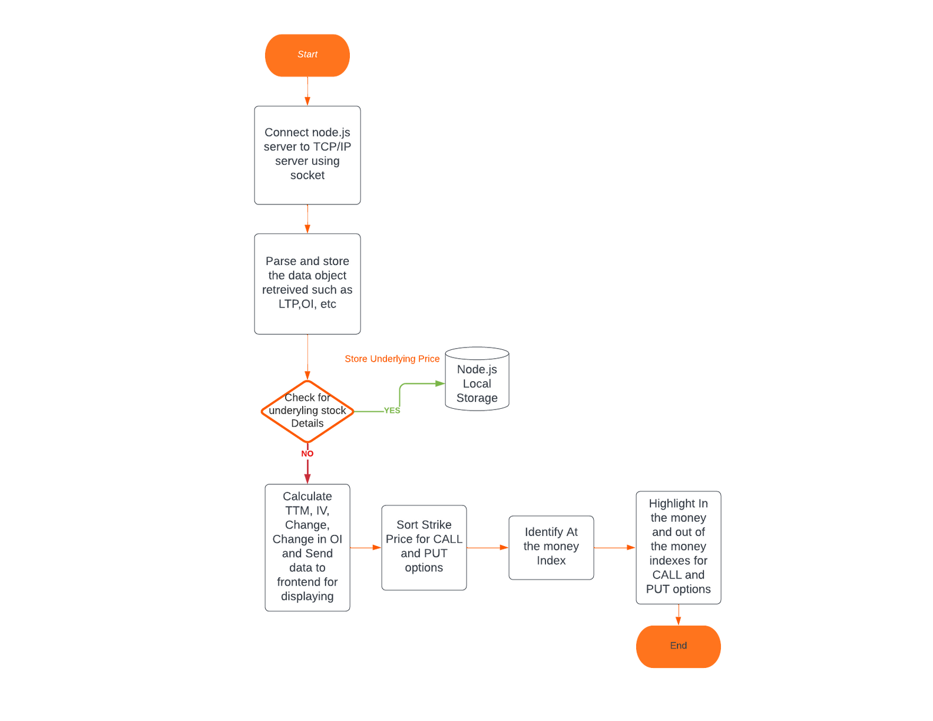
Flow Chart

Slide 7

Our USPs
Interactive and Clean User Interface
Realtime updates without manual reload
Minimal latency between data reception and relaying
Filtering Options based on Option Name.
Highlighting of In the money and Out of the money options

Slide 8
Why our Solution Should be Considered for the final round
All three primary conditions which were connection to TCP/IP using socket, Calculation of IV, and development of UI were satisfied.
Calculated IV value is pretty accurate.
We have highlighted the in the money and out of the money indexes for Call and Put options.
Simplistic solution avoiding complexity and achieving maximum performance

Slide 9






Tech Stack
FrontEnd | HTML CSS ReactJS
BackEnd | NodeJS ExpressJS
Database | Server Local Storage
HTML
CSS

Slide 10
Thank You

